Slide 1
Matrix Actions on Bivariate Polynomials
Michelle Bergeron
Mathematics Capstone
Advisor: John Duncan

Slide 2
Mathematical Foundations

Slide 3
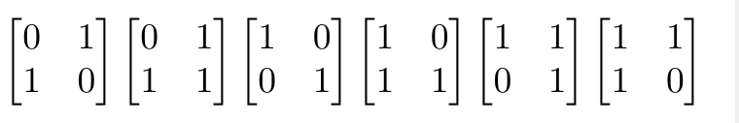
SL2 Mod (n)
Defined over commutative ring with unity
All 2 x 2 matrices with determinant 1 with entries mod n

Slide 4
Polynomials with Coefficients mod n
R[x,y]k is the ring of polynomials…
Variables x and y
Degree k
Coefficients in R = Z mod n
Has form ax^{k} y^{k} , a ∈ R
R[x,y]k contains n^{(k+1)} elements

Slide 5
R[x,y]2: Example
R = Integers mod 2, k = 2
Generate R[x,y]2 by plugging in elements of R:
0x² + 0xy + 0y² = 0
1x² + 0xy + 0y² = x²
0x² + 1xy + 0y² = xy
0x² + 0xy + 1y² = y²
1x² + 0xy + 1y² = x² + y²
1x² + 1xy + 0y² = x² + xy
0x² + 1xy + 1y² = xy + y²
1x² + 1xy + 1y² = x² + xy + y²

Slide 6
Matrix Actions on R[x,y]_{k}

Slide 7
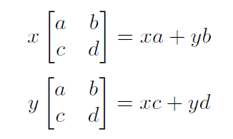
Matrix Action Definition
For a polynomial in R[x,y]k and a matrix in SL2 mod n:

Slide 8
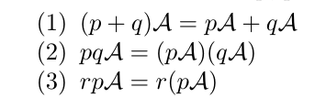
Additional Rules
For matrix A, polynomials p and q, and constant r:

Slide 9
Example in SL2 mod 2

Slide 10
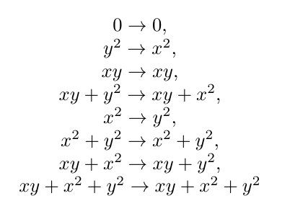
Continue for the rest of R[x, y]2…
Note that 0 and x² + xy + y² map to themselves!

Slide 11
Orbits
Repeat the action on R[x, y]2 using SL2 mod 2.
We find that {0} and {x² + xy + y²} always map to themselves in SL2 mod 2!

Slide 12
Higher dimensions of R[x, y]k
We can continue this process in k = 3, 4, 5, etc.
New notation: R[x, y]k = k + 1
Continue the action on 4, 5, 6, etc…

Slide 13
“Copies”
For SL2 mod 2:
If you look in 3, you can find elements that behave exactly like those in 1 and 2 as far as their mappings go.
We call them “copies” of 1 and 2.
No matter how high the dimension, we would still find copies of 1 and 2.
1 and 2 are irreducible (contain no copies) in SL2 mod 2

Slide 14
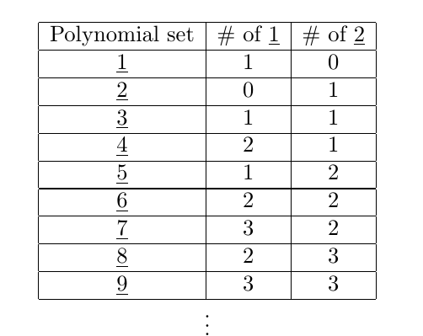
SL2 mod 2

Slide 15
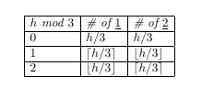
SL2mod 2
Define formulas for each row in the table. For row h, take h mod 3:

Slide 16
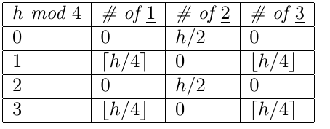
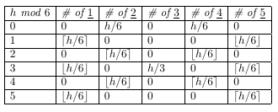
SL2 mod 3 and 5
SL2 mod 3: Take h mod 4:
SL2 mod 5: take h mod 6:

Slide 17
Generalizations in SL2 mod n
For SL2 mod n, 1…. n are irreducible!
Link between SL2 mod n and R[x, y]k
Every table has a pattern of period n+1.
Every table can be created with entries including combinations of the ceiling and floor of h/(n+1).

Slide 18
Future work
Future research possibilities:
Generalize a formula for any table in SL2 mod n
Bigger matrices/polynomials in more variables?

